Slide 1

Praktikum
Pemrograman Interpreter
Ardella Dean Awalia
Imam Akbar

Slide 2
Conditional Logic

Slide 3
If
Syntax
if condition:
statement
Contoh :
x = 10
if x > 0:
print(x, ‘Bilangan Positif’)

Slide 4
Else
Syntax
if condition:
statement
else condition:
statement
Contoh :
umur = int(input(‘masukkan umur: ‘))
if umur >= 12:
print(‘Boleh vaksin’)
else:
print(‘Maaf, vaksin ditunda’)

Slide 5
Elif
Syntax
if condition:
statement
elif condition:
statement
...
else condition:
statement
Contoh :
nilai = int(input(‘Masukan nilai: ‘))
if nilai > 90:
print(‘Excellent’)
elif nilai > 76:
print(‘Great’)
elif nilai > 60:
print(‘Good’)
else:
print(‘Failed’)

Slide 6
if - else single statement
Syntax
statement if condition else condition
Contoh :
x = int(input(‘Input x: ‘))
y = int(input(‘Input y: ‘))
print(‘x is more than y’) if x>y else print(‘x is not more than y’)

Slide 7
if - else multiple statement
Syntax
statement if condition else condition if condition else statement
Contoh :
x = int(input(‘Input x: ‘))
y = int(input(‘Input y: ‘))
print(‘x is more than y’) if x>y else print(‘x is equal to y’) if x==y else print(‘x is less than y’)

Slide 8
Nested if
Syntax
if condition:
statement
if condition:
statement
...
...
...

Slide 9
Ternary Operator
Syntax
if condition:
condition_if_true
else:
condition_if_false
condition_if_true if condition else condition_if_false

Slide 10
Ternary Operator
Contoh :
lulus = True
if (lulus):
say = ‘Selamat’
else:
say = ‘Perbaiki’
say = ‘Selamat’ if lulus else ‘Perbaiki’

Slide 11
Ternary Tuples
Syntax
if condition:
condition_if_true
else:
condition_if_false
(condition_if_false, condition_if_true)[condition]

Slide 12
Ternary Tuples
Contoh :
lulus = True
if (lulus):
say = ‘Selamat’
else:
say = ‘Perbaiki’
say = (‘Perbaiki’, ‘Selamat’)[lulus]

Slide 13
Error Handling

Slide 14
Errors
Errors in Python :
Syntax error
Exceptions
Syntax Error
Kesalahan dalam penulisan syntax.
contoh :
x = 1
if x > 0
print(‘Bilangan Positif’)
#akan ada peringatan SyntaxError karena dalam penulisan if tidak disertai :

Slide 15
Errors
Exceptions more : https://docs.python.org/id/3.8/library/exceptions.html
ZeroDivisionError
NameError
TypeError
ZeroDivisionError
terjadi saat melakukan pembagian dengan pembagi angka 0
NameError
dapat terjadi saat variabel belum dideklarasi
TypeError
dapat terjadi saat melakukan operasi dengan tipe data berbeda

Slide 16
Error Handling
Contoh :
x = 10
try :
hasil = x/0
print(hasil)
except ZeroDivisionError:
print(‘pembagian dengan 0 tidak dapat dilakukan’)

Slide 17
Error Handling
Multiple Exceptions
foods = {1:'Burger’, 2:’Pizza’}
try :
print(‘Pesan : {}’.format(foods[3]))
except KeyError:
print(‘tidak ditemukan kunci pada dictionary foods’)
except ValueError:
print(‘value tidak sesuai’)

Slide 18
Error Handling
Multiple Exceptions in one except statement
foods = {1:'Burger’, 2:’Pizza’}
try :
print(‘Pesan : {}’.format(foods[3] / 5))
except KeyError:
print(‘tidak ditemukan kunci pada dictionary foods’)
except (ValueError, TypeError):
print(‘value atau tipe tidak sesuai’)

Slide 19
Error Handling
Exceptions as tuple
foods = {1:'Burger’, 2:’Pizza’}
try :
print(‘Pesan : {}’.format(int(foods[1])))
except KeyError:
print(‘tidak ditemukan kunci pada dictionary foods’)
except (ValueError, TypeError) as err:
print(‘Error: {}’.format(err))

Slide 20
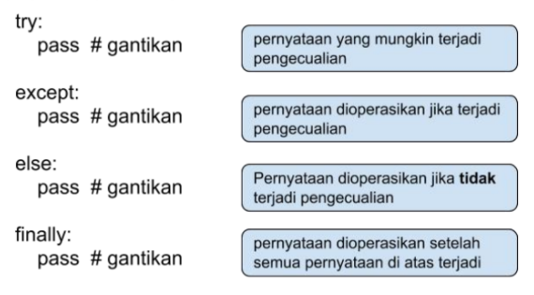
Error Handling
Syntax

Slide 21
Error Handling
Raising Error
foods = {1:'Burger’, 2:’Pizza’}
if 3 not in foods:
raise KeyError(‘tidak ada kunci 3’)

Slide 22
Thank You

